Slide 1
Week 4 (2) – Exhaustive Search
CST370 – Design & Analysis of Algorithms
Dr. Byun
Computer Science

Slide 2
Lecture Objectives
After completion of this lecture, you will be able to
  understand the operation of exhaustive search to solve the traveling salesman problem (TSP).
  use exhaustive search to solve the knapsack problem.

Slide 3
Chapter 3: Brute Force and Exhaustive Search
3.1 Selection Sort and Bubble Sort
3.2 Sequential Search and Brute-Force String Matching
3.3 Closest-Pair and Convex-Hull Problems by Brute Force
3.4 Exhaustive Search
3.5 Depth-First Search and Breadth-First Search

Slide 4
<<< Course Instruction >>>
Read pages 115-116 in the textbook and proceed to the next slide.
  Exhaustive search is a brute-force approach to combinatorial problems.
    Generate all potential solutions to the problem.
    Evaluate each potential solution one by one.
    Determine the final solution.

Slide 5
Traveling Salesman Problem (TSP)
TSP is to find the shortest tour through a given set of n cities that visits each city exactly once before returning to the city where it started.
Example: Figure 3.7.

Slide 6
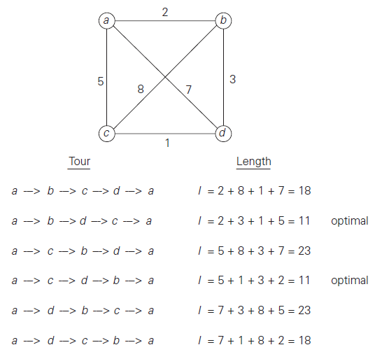
TSP Example: Figure 3.7
To solve the problem, you must find all permutations of the nodes b, c, and d.

Slide 7
Time Complexity of TSP
  If there are n nodes in the question, you need to identify all possible paths of the (n-1) node, except for the start node and the end node that is the start node.
  The total possible path is
  (n-1)! = (n-1) * (n-2) * … * 2 *1
  Therefore, the time efficiency of the problem requires at least (n-1)!

Slide 8
Knapsack Problem
This is a well-known problem in computer science.
  Given n items of weights w₁, w₂, . . . , w_{n} and values v₁, v₂, . . . , v_{n} and a knapsack of capacity W, find the most valuable subset of the items that fit into the knapsack.
Example
  Knapsack capacity: 10 (i.e.: W = 10)
  Item 1: w₁ = 7, v₁ = $42
  Item 2: w₂ = 3, v₂ = $12
  Item 3: w₃ = 4, v₃ = $40
  Item 4: w₄ = 5, v₄ = $25

Slide 9
Basic Idea to Solve Knapsack Problem
Generate all the subsets of the set of n items.
Compute the total weight of each subset.
Find the subset of the largest value among them.

Slide 10
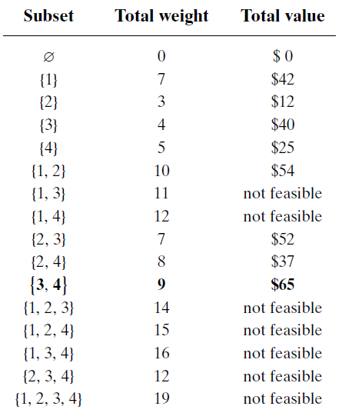
Example: 16 subsets for 4 items

Slide 11
<<< Course Instruction >>>
Read pages 116-119 (before “Assignment Problem”) in the textbook and proceed to the next slide.

Slide 12
Time Efficiency of Knapsack Problem
Note that the number of possible subsets of a set with n items is 2^{n}.
  Thus, the exhaustive search algorithm requires at least (2^{n}) time complexity.
  For example, the solution to the question in Figure 3.8 has 16 (= 2⁴) subsets for a set of 4 items.

Slide 13
<<< Course Instruction >>>
This lecture is over.
  If you do not understand any part in the lecture, study it again.
  Otherwise, start the “week_4_3.ppt” to prepare the midterm-I on Jan 25 (Saturday).

